Slide 1

Computational Physics (PHYS6350)
Lecture 7: Non-linear equations and root-finding: Part 2
Roots of polynomials
Systems of non-linear equations
Function extrema
February 6, 2025
Instructor: Volodymyr Vovchenko (vvovchenko@uh.edu)
Course materials: https://github.com/vlvovch/PHYS6350-ComputationalPhysics/tree/spring2025

Slide 2
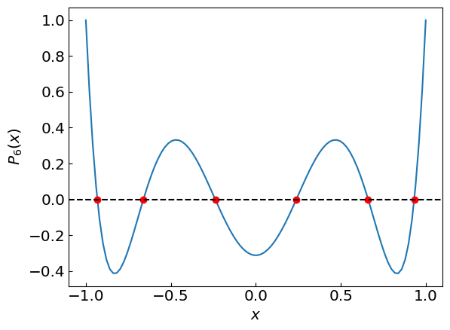
Roots of polynomials
References:
Chapters 5.1, 9.5 of Numerical Recipes Third Edition by W.H. Press et al.

Slide 3
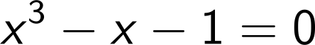
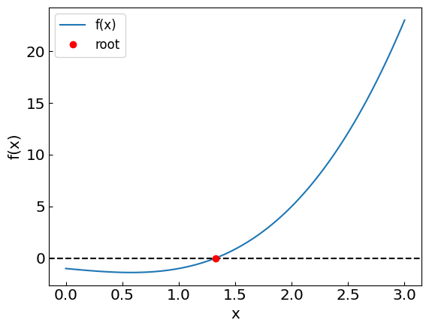
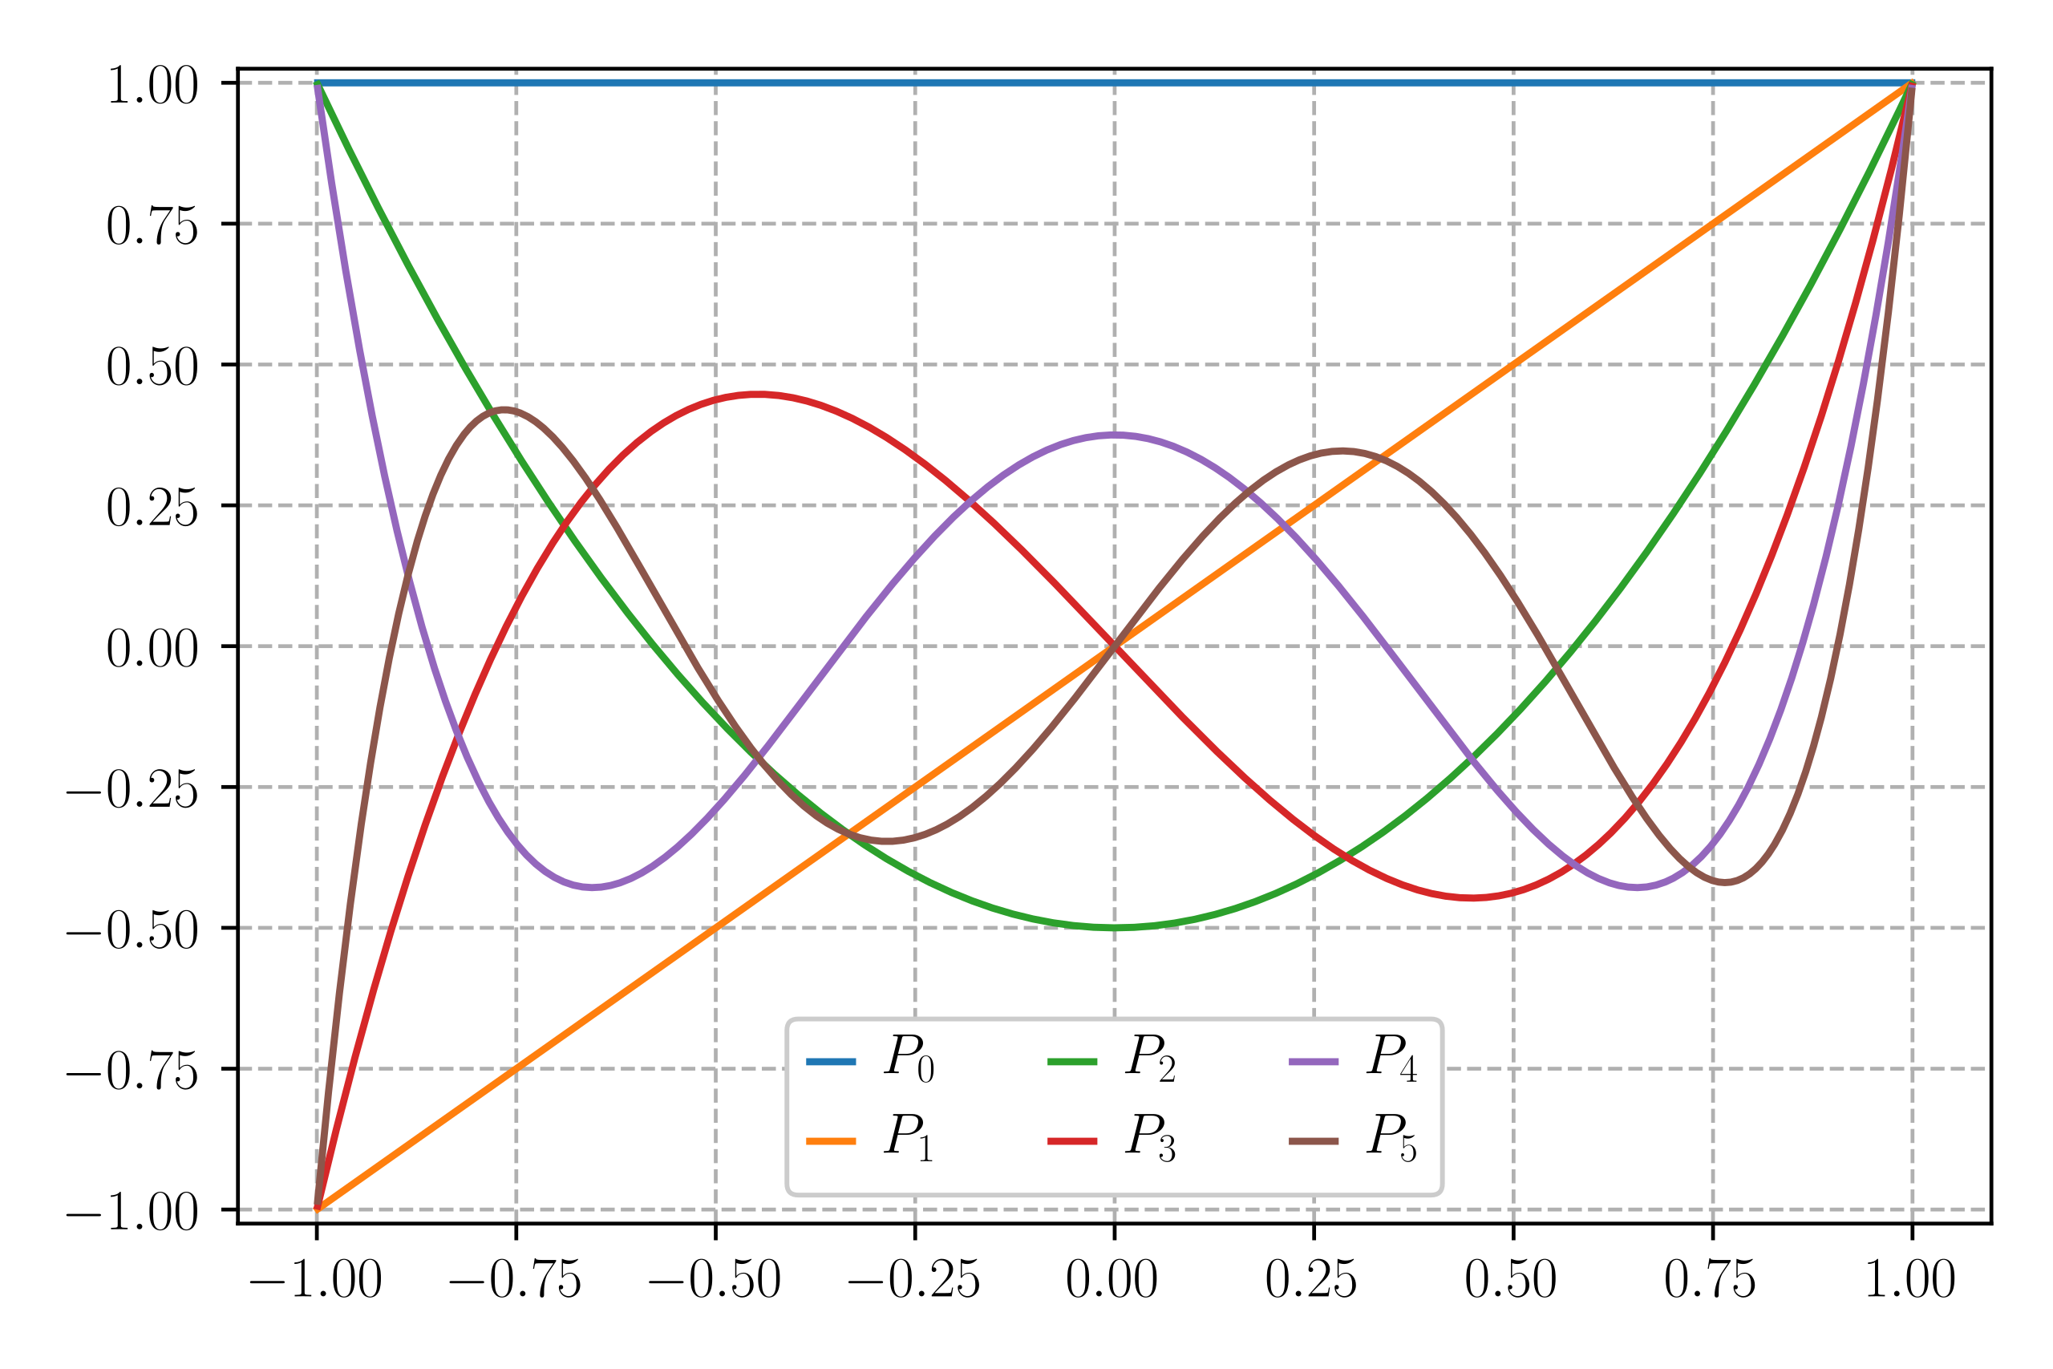
Roots of polynomials
So far we’ve dealt with polynomials with one real root, such as
Other polynomials (e.g. Legendre polynomials) have multiple real roots, and we need to calculate them all

Slide 4
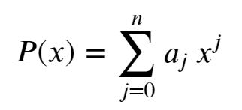
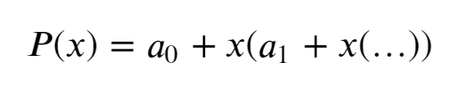
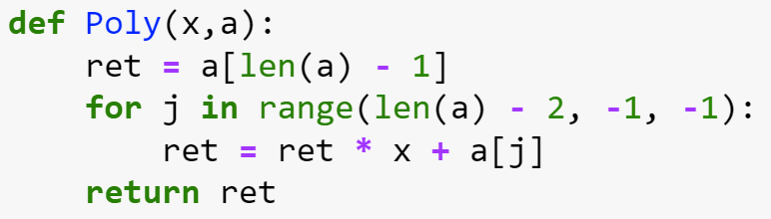
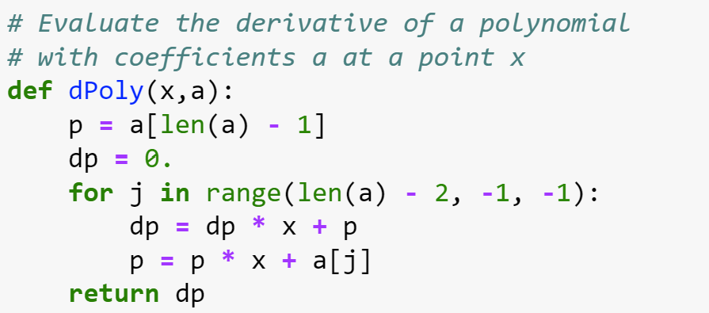
Preliminaries: evaluating polynomials efficiently
A polynomial can typically be written as
or, equivalently, as
which allows one to evaluate both the polynomial and its derivative efficiently

Slide 5
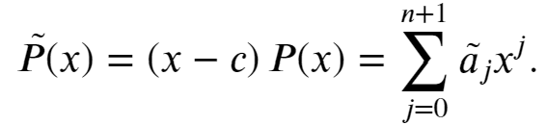

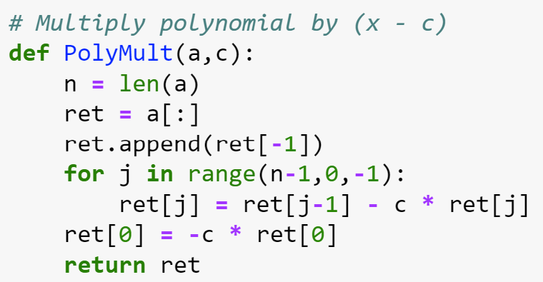
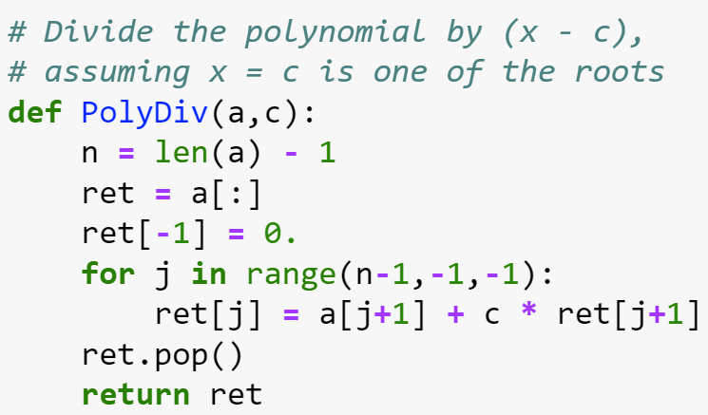
Preliminaries: multiplying and dividing a polynomial
Multiplication:
Multiply by to get
Easy to see that
Division:
Inverting these relations defines the division of $\tilde{P}(x)$ by (x-c)
Note that the division only makes sense when x=c is a root of $\tilde{P}(x)$

Slide 6
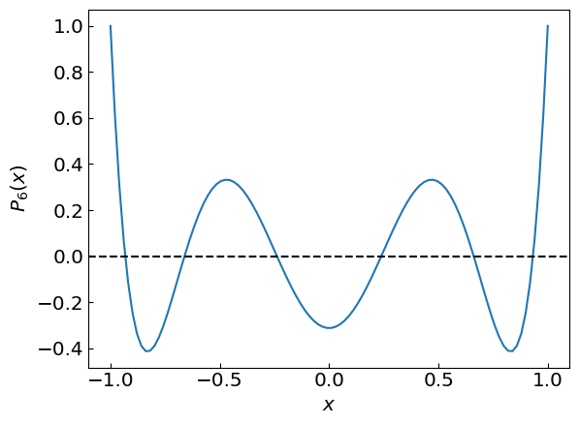
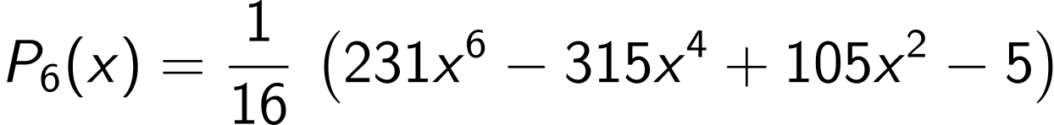
Roots of Legendre polynomials
Roots of Legendre polynomials $P_{n}(x)$ play an important role e.g. for numerical integration using quadratures
Each $P_{n}(x)$ has n real roots in the interval x = -1…1
Consider
How to evaluate its six roots accurately?

Slide 7
Roots of Legendre polynomials
Strategy 1: Bracket each root from visual analysis and use the bisection method for refinement

Slide 8
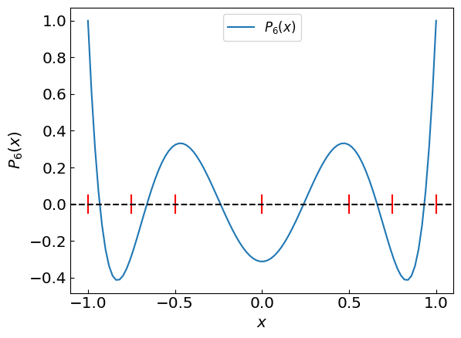
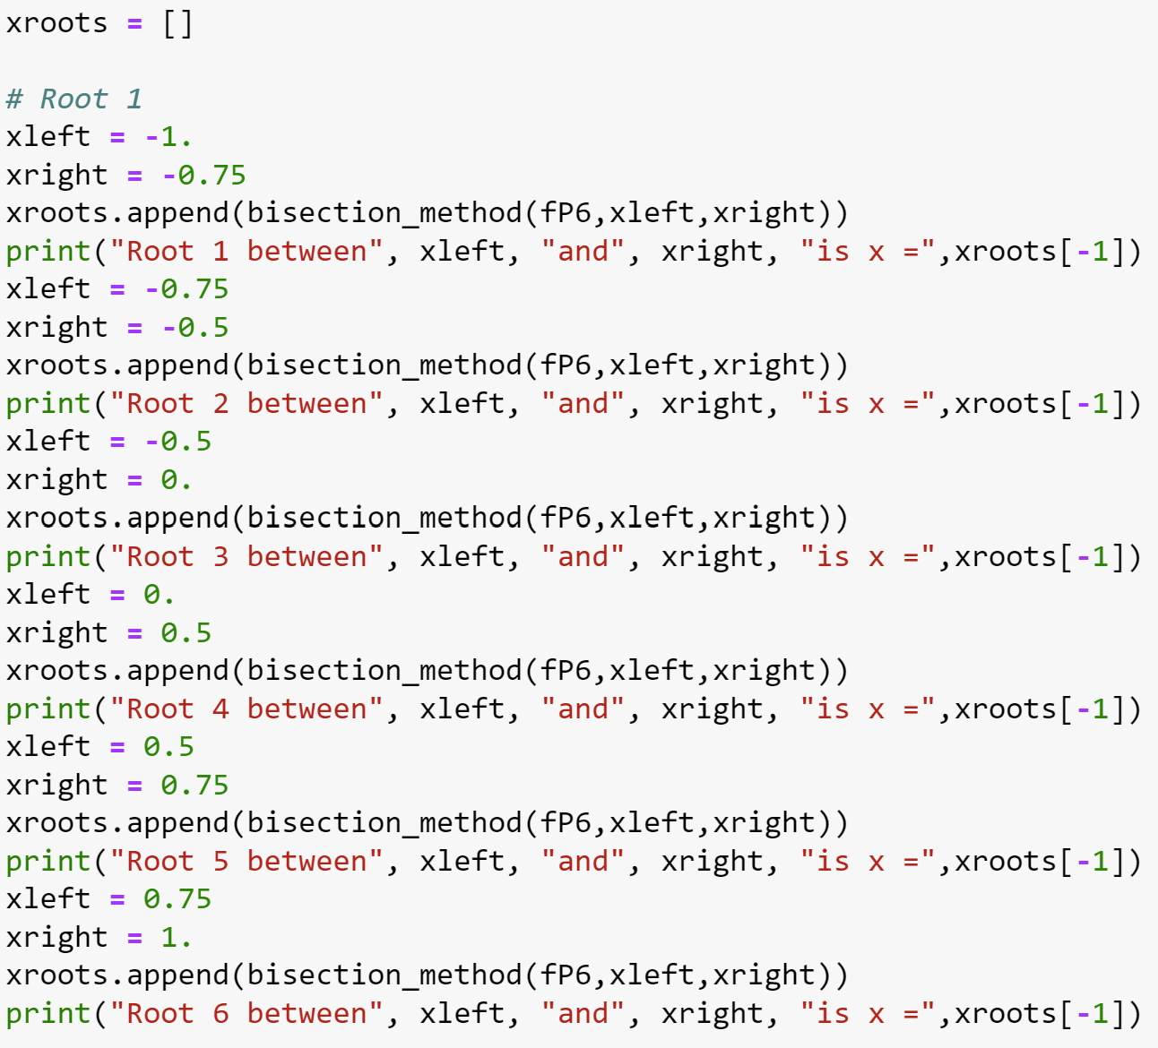
Roots of Legendre polynomials
Strategy 1: Bracket each root from visual analysis and use the bisection method for refinement

Slide 9
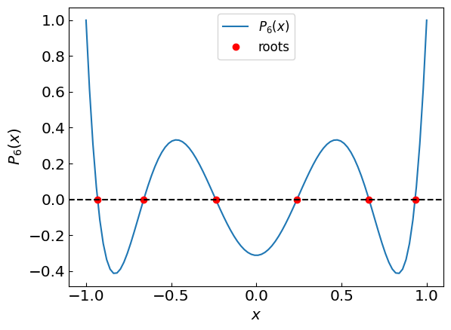
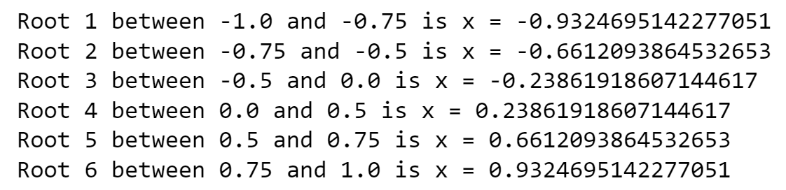
Roots of Legendre polynomials
Strategy 1: Bracket each root from visual analysis and use the bisection method for refinement

Slide 10
Roots of Legendre polynomials
Strategy 1 is fairly fail-safe but requires significant manual pre-processing
Strategy 2:
Use one of the standard methods (e.g. Newton-Raphson) to find the first root x₁
Divide the polynomial by (x-x₁)
Apply Newton’s method to the new polynomial to find x₂
Divide the polynomial by (x-x₂) and repeat the above steps until all roots are found
Optional optimization:
Refine the roots by applying Newton-Raphson method again to the original polynomial, using the tentative roots as initial guesses
This helps to mitigate round-off error accumulation inherent in polynomial division

Slide 11
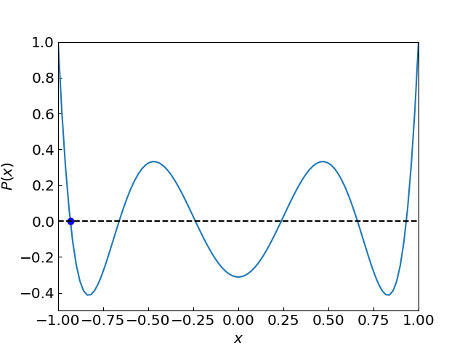
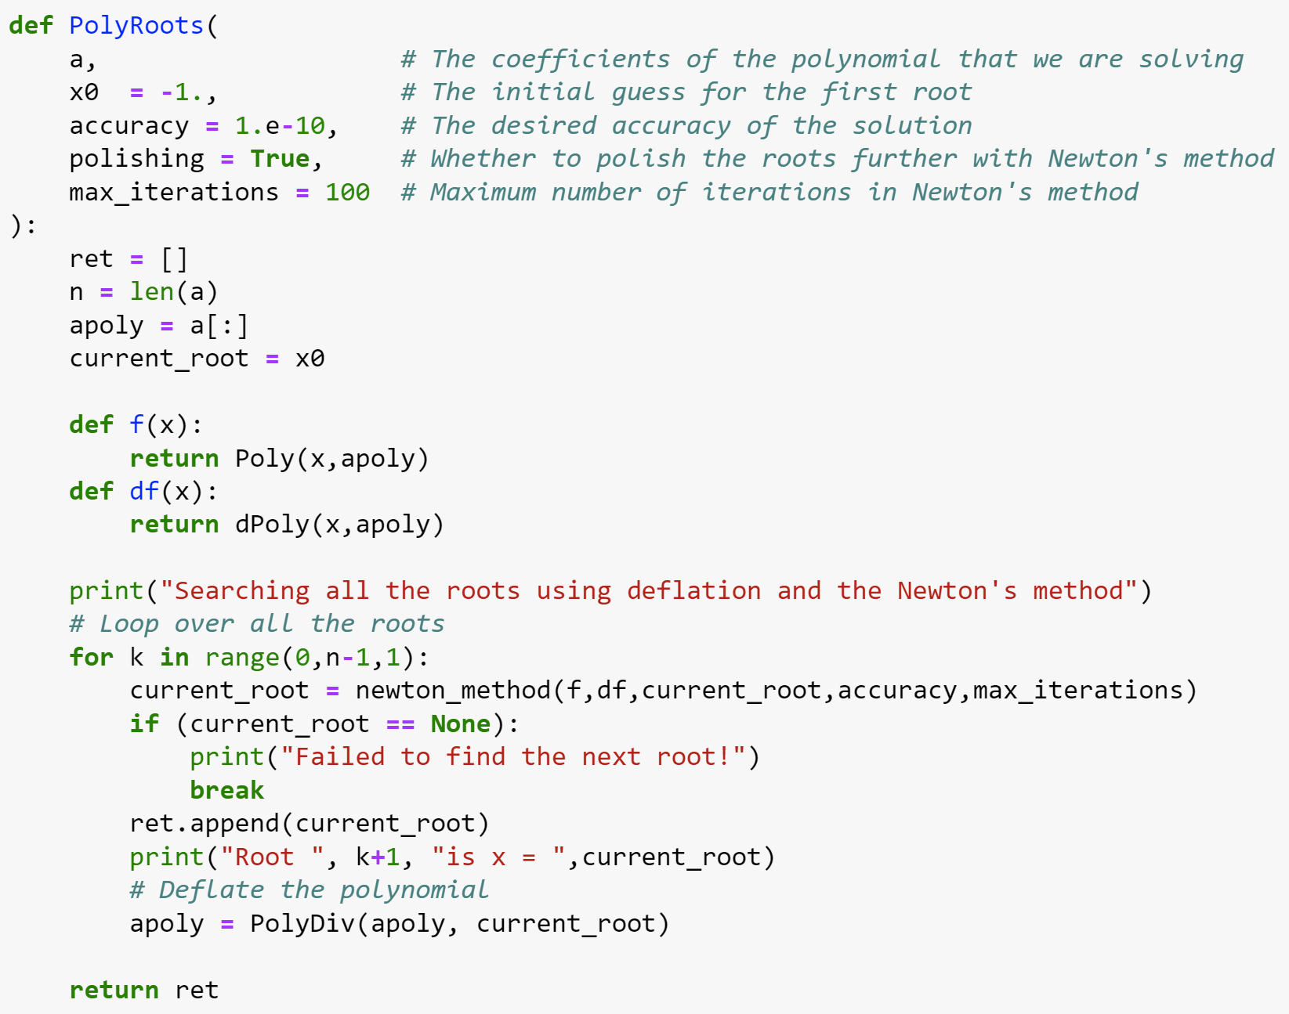
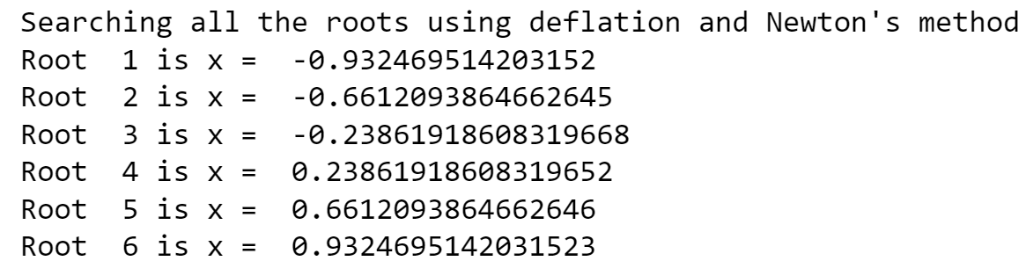
Roots of Legendre polynomials
Using strategy 2, initial guess x₀ = -1

Slide 12
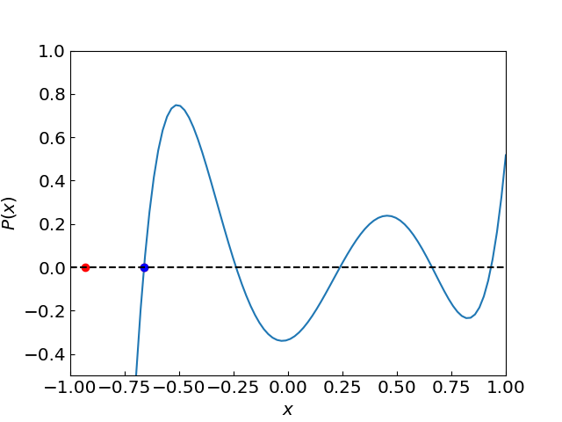
Roots of Legendre polynomials
Using strategy 2, initial guess x₀ = -1

Slide 13
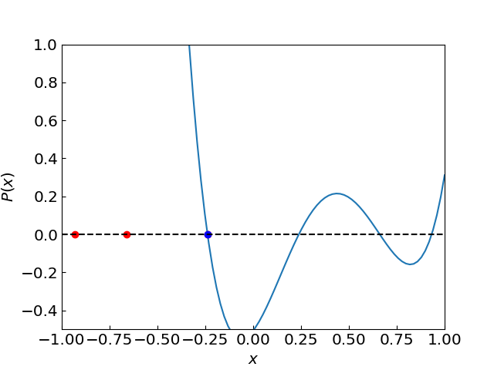
Roots of Legendre polynomials
Using strategy 2, initial guess x₀ = -1

Slide 14
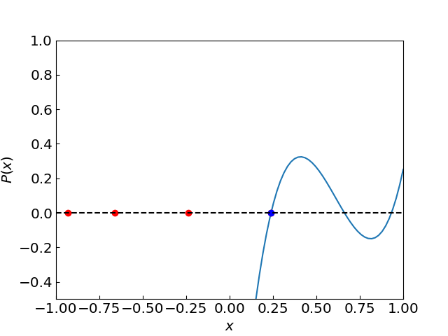
Roots of Legendre polynomials
Using strategy 2, initial guess x₀ = -1

Slide 15
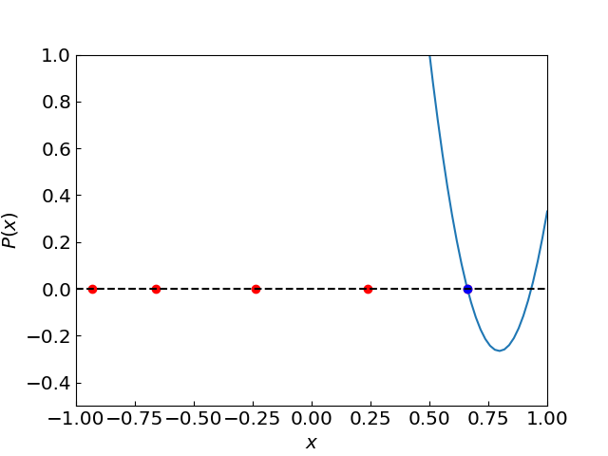
Roots of Legendre polynomials
Using strategy 2, initial guess x₀ = -1

Slide 16
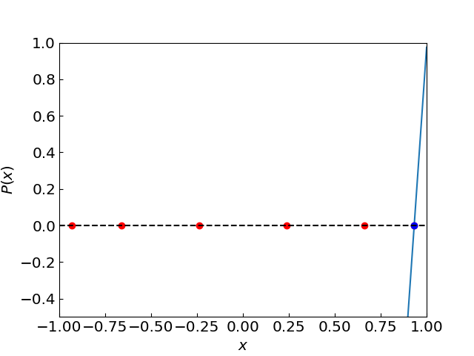
Roots of Legendre polynomials
Using strategy 2, initial guess x₀ = -1

Slide 17
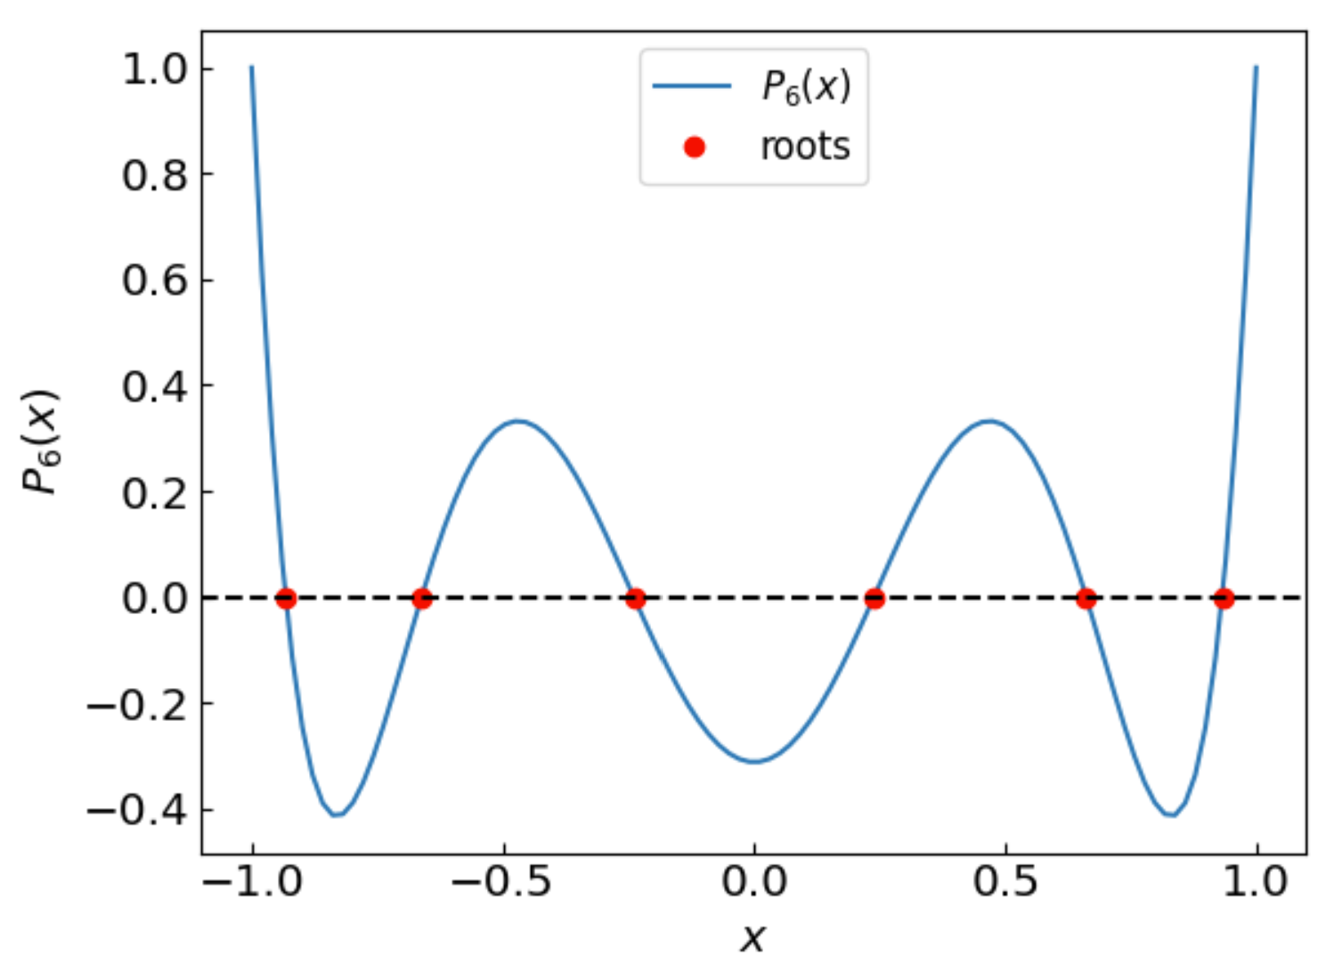
Roots of Legendre polynomials
Using strategy 2, initial guess x₀ = -1

Slide 18
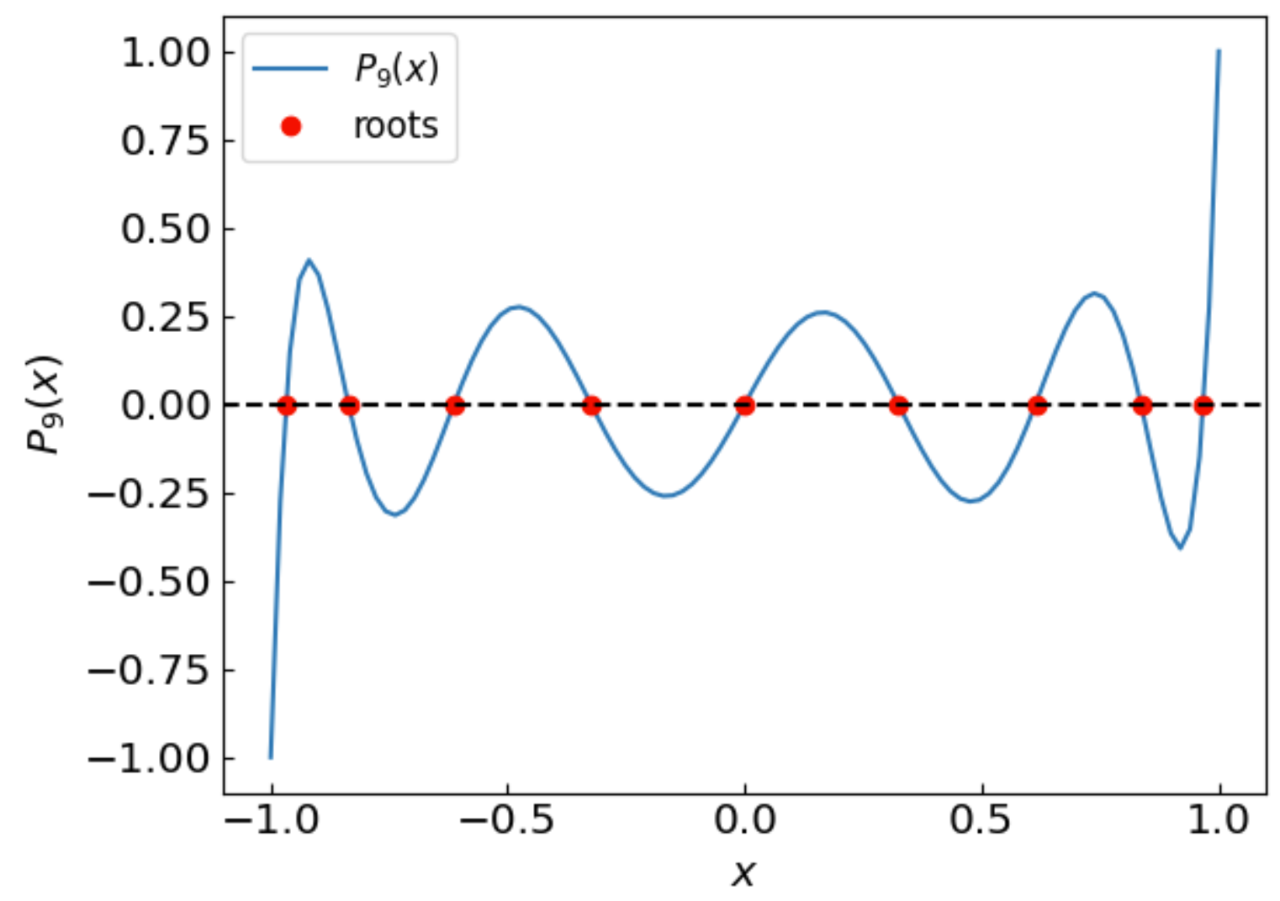
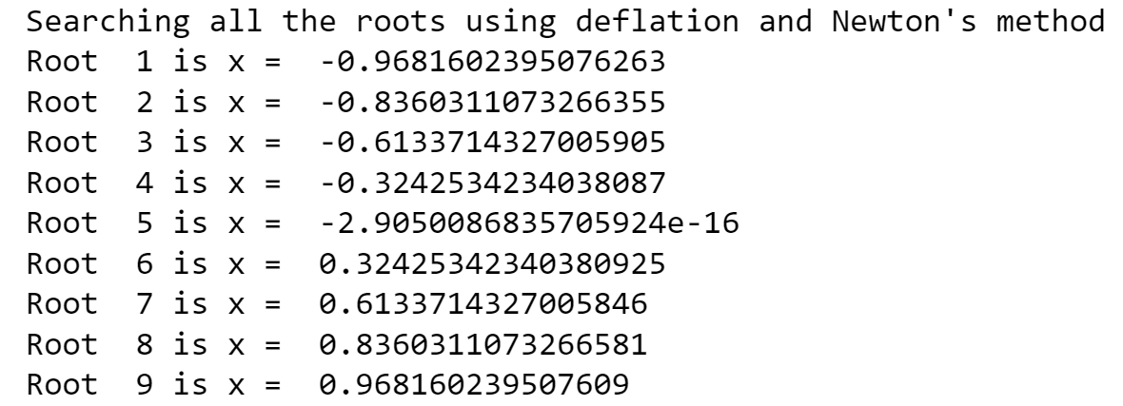
Roots of Legendre polynomials
Same procedure for $P_{9}(x)$
Try to go higher order? How high can we go?

Slide 19
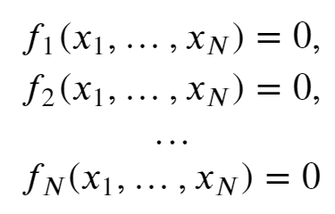
Systems of non-linear equations
References:
Chapter 9.6 of Numerical Recipes Third Edition by W.H. Press et al.

Slide 20
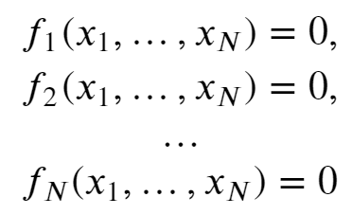
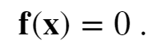
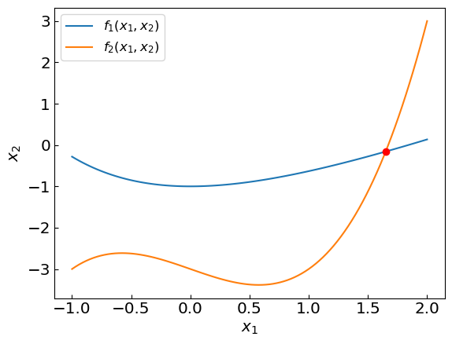
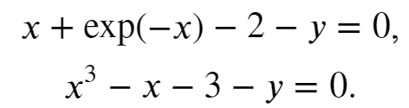
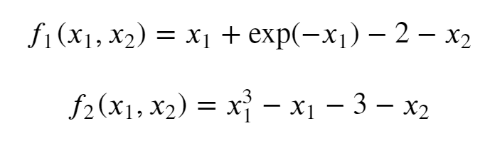
Systems of non-linear equations
Often, we need to solve a system of coupled non-linear equations, e.g.
Vector notation: f = (f₁,…,f_{N}) and x = (x₁,…,x_{N})
For example:
i.e.

Slide 21
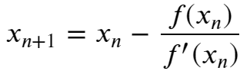

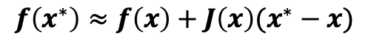
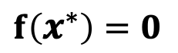
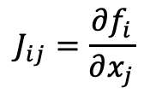
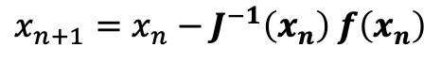
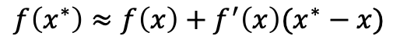

Newton-Raphson method in multiple dimensions
We have a system on non-linear equations f(x) = 0
Taylor expansion around the root x* reads (multi-variate calculus)
$$f\left(x^{∗}\right)≈f\left(x\right)+J\left(x\right)(x^{∗}−x)$$
1D:
$$f\left(x^{∗}\right)≈f\left(x\right)+f^{′}\left(x\right)(x^{∗}−x)$$
$J\left(x\right)$ is the Jacobian, i.e. a NxN matrix of derivatives evaluated at x:
$$J_{ij}=\frac{∂f_{i}}{∂x_{j}}$$
$$f\left(x^{∗}\right)=0$$
$$J\left(x\right)\left(x^{∗}−x\right)≈−f\left(x\right)$$
$$x^{∗}≈x−J^{−1}\left(x\right) f\left(x\right)$$
The multi-dimensional Newton’s method is an iterative procedure:
$$x_{n+1}=x_{n}−J^{−1}\left(x_{n}\right) f\left(x_{n}\right)$$
In 1D reduces to Newton-Raphson:

Slide 22
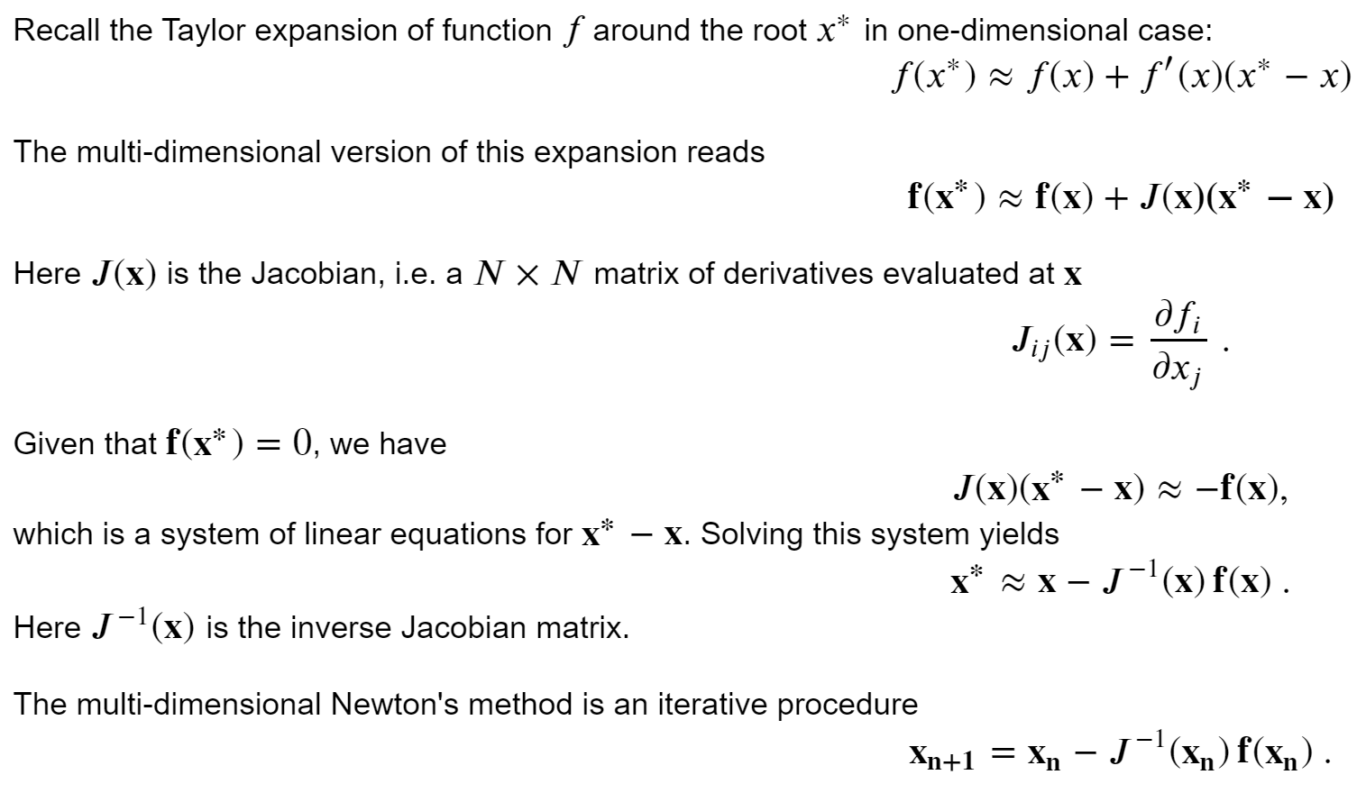
Newton-Raphson method in multiple dimensions
Reduces to Newton’s method in 1D

Slide 23
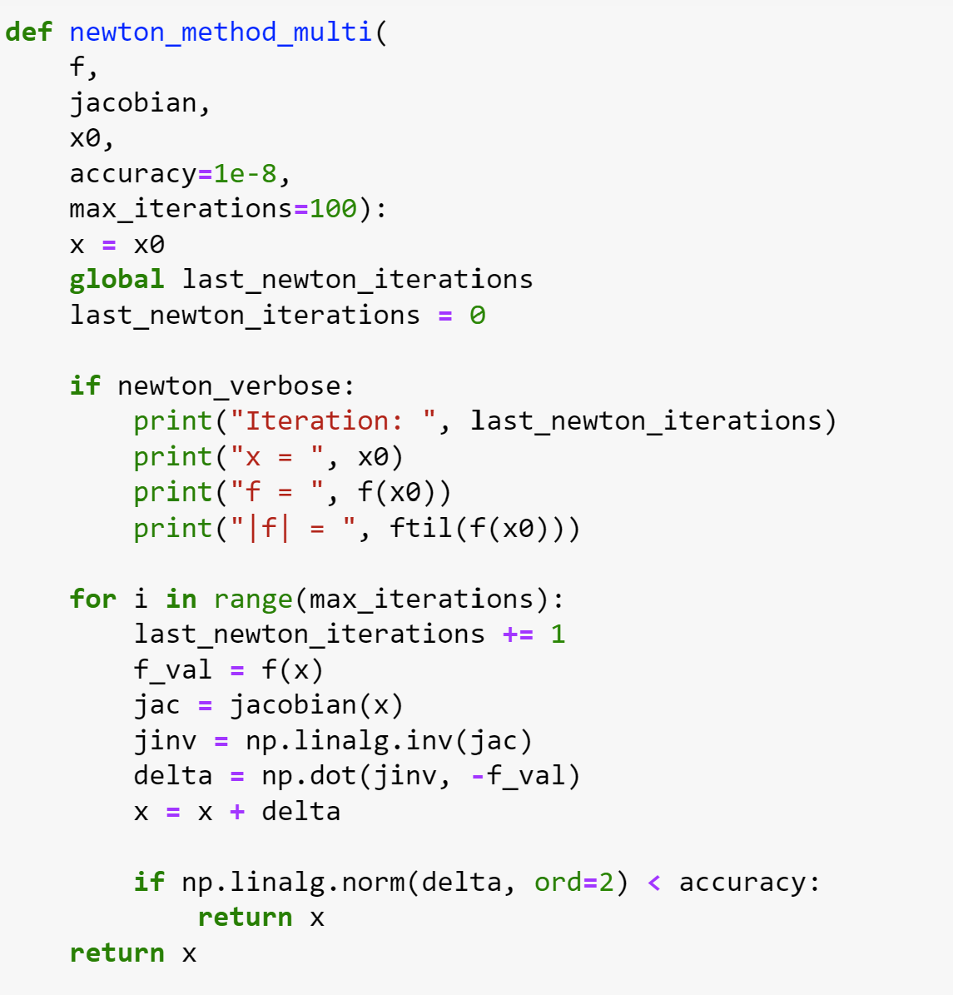
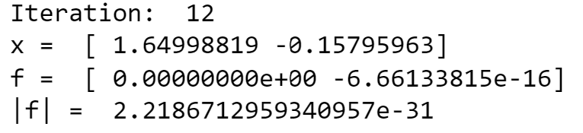
Newton-Raphson method in multiple dimensions

Slide 24
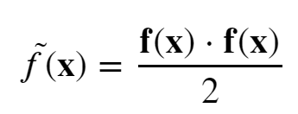
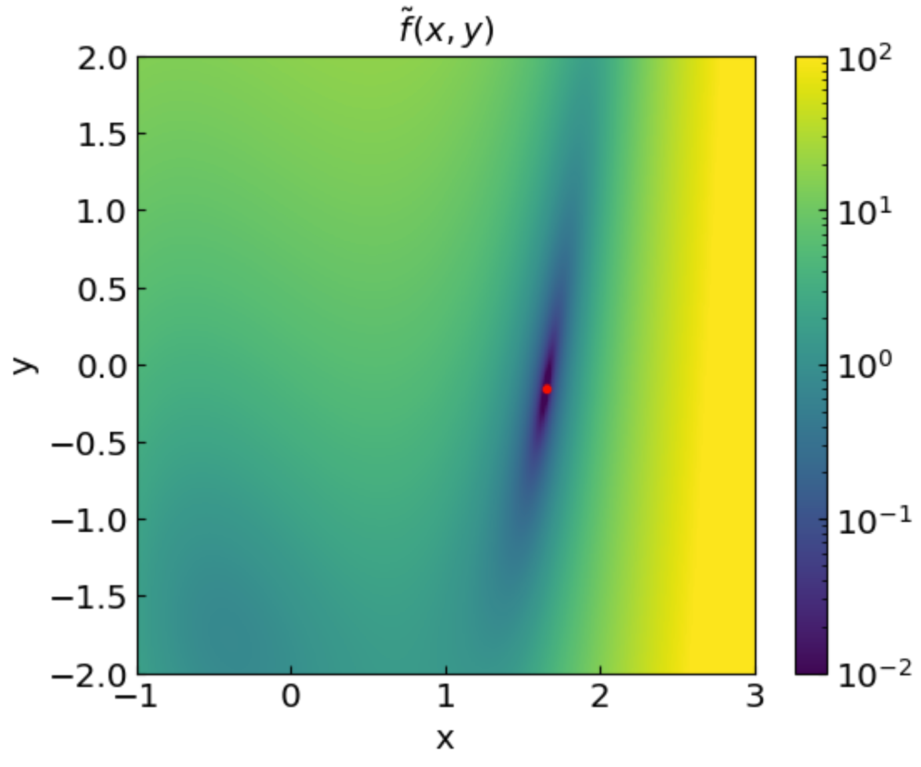
Newton-Raphson method in multiple dimensions
Introduce an objective function
Its value is equal to zero (minimized) at the root

Slide 25
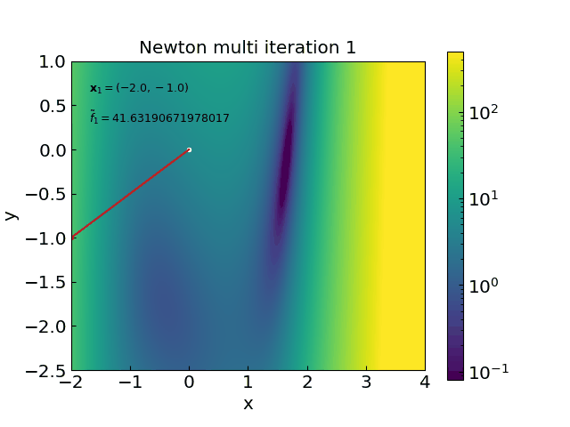
Newton-Raphson method in multiple dimensions

Slide 26
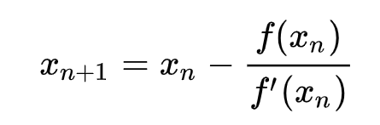
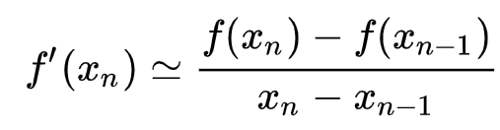
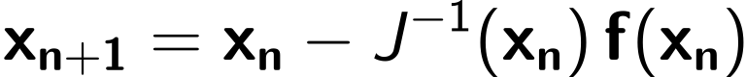
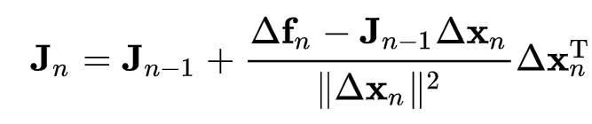


Broyden method
Broyden method is a multi-dimensional generalization of the secant method
Secant method (1D):
with
Broyden method:
with
The solution for J(x_{n}) is not unique
Broyden:
with
For $J_{0}$ one can take the identity matrix or full Jacobian calculated once
Initial Jacobian $J_{0}$:
Calculate the Jacobian J(x₀)
Initialize with Identity matrix J(x₀) = I
requires derivative but more accurate
no derivative but can converge slower

Slide 27



Broyden method (direct)

Slide 28

Broyden method: avoid matrix inversion
Sherman-Morrison formula:
Update the inverse Jacobian directly!

Slide 29


Broyden method (Sherman-Morrison)

Slide 30
Broyden method vs Newton-Raphson method
Broyden method converges somewhat slower (54 vs 12 iterations in our example) but:
Does not involve the calculation of Jacobian
Does not involve matrix inversion

Slide 31

Broyden method vs Newton-Raphson method
Broyden method converges somewhat slower (e.g. 54 vs 12 iterations in our example) but:
Does not involve the calculation of Jacobian
Does not involve matrix inversion
Possible refinement: improve the initial estimate for the Jacobian

Slide 32

Function minimization/maximization
References:
Chapter 6.4 of Computational Physics by Mark Newman
Chapter 10 of Numerical Recipes Third Edition by W.H. Press et al.

Slide 33

Function extrema
Often we are interested to find the minimum of a function (e.g. energy minimization)
Consider the minimum of f(x) = sin(x) on interval 0..2$π$

Slide 34




Golden section search
Bracket the minimum x_{min} in (a,b)
Take c = b – (b-a)/$φ$ and d = a + (b-a)/$φ$
If f(c)<f(d), take b = d as new right endpoint
Otherwise, take a = c as new left endpoint
Repeat over the new, smaller interval (a,b) until the desired accuracy is reached
$$φ=\frac{1+\sqrt{5}}{2}=1.618…$$
is the golden ratio
This value ensures that the interval decreases by factor $φ$ in each iteration no matter what
The method works when the function is unimodal

Slide 35


Golden section search
To search for a maximum of f(x) look for a minimum of –f(x)

Slide 36




Newton-Raphson method
The extremum of f(x) is the root of the derivative, $f^{′}\left(x\right)=0$
Simply apply Newton-Raphson method (or one other standard methods) for finding the root of $f^{′}\left(x\right)$

Slide 37





Gradient descent method
Replace, ${f′}^{′}\left(x\right)$ by a descent factor $1/γ_{n}$
$γ_{n}>0$ (minimum)
$γ_{n}<0$ (minimum)
Freedom in choosing $γ_{n}$
Can be generalized to multi-variable function F(x₁,x₂,...)
final project idea(?)

